Slide 1
Mary Kay Inventory System with POS
(Midterm presentation) made by: Kevin Matthew Austria
Princess Hannah Bangibang
Ruby Elizabeth Bisbal
Henley Mccoy Macagba

Slide 2
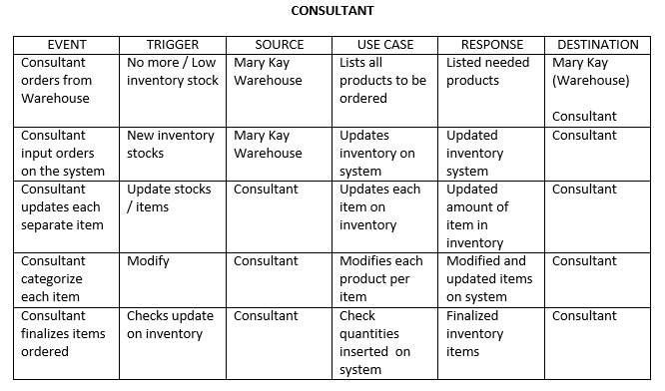
Event Table

Slide 3
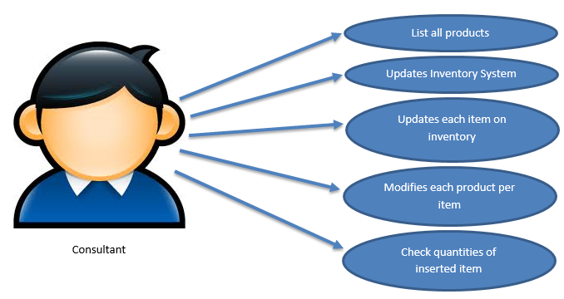
Use Case

Slide 4
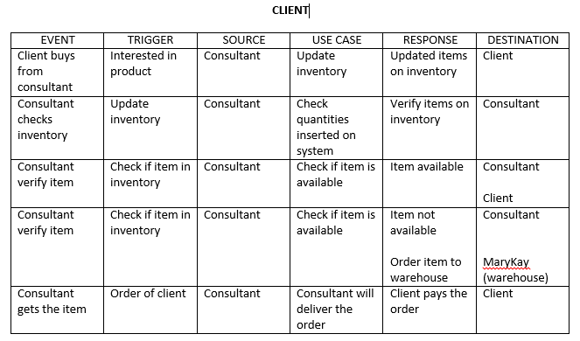
Event Table

Slide 5
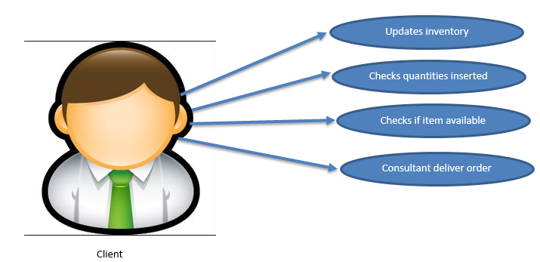
Use Case

Slide 6
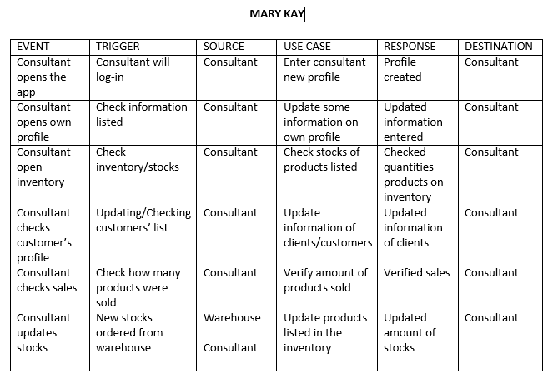
Event Table

Slide 7
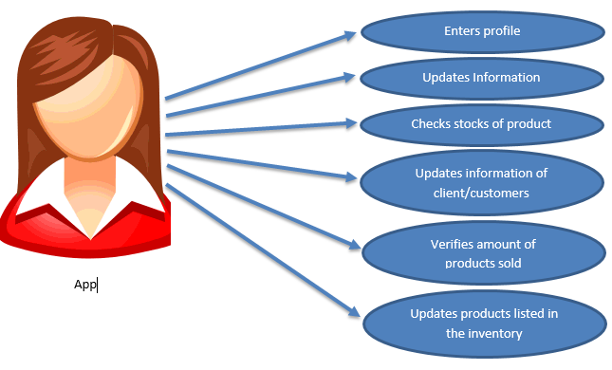
Use Case

Slide 8
Context Flow Diagram (CFD

Slide 9
Data Flow Diagram (DFD)

Slide 10
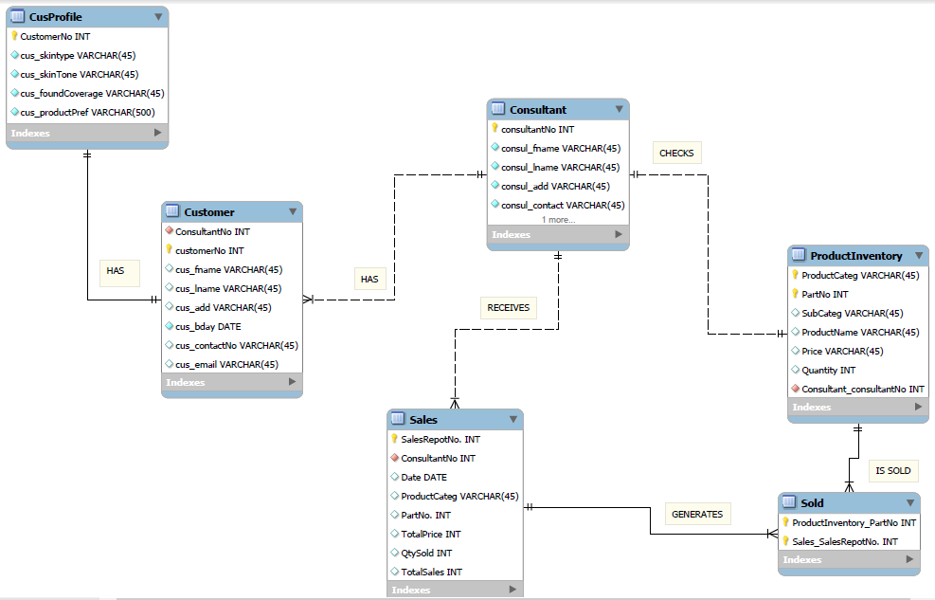
ENTITY RELATIONSHIP DIAGRAM (ERD)

Slide 11
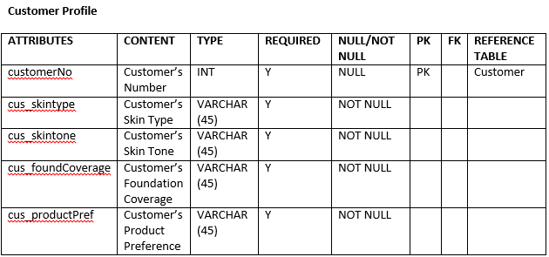
DATA DICTIONARY

Slide 12
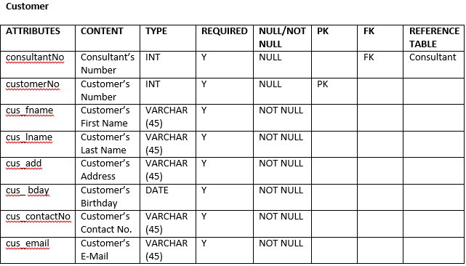
DATA DICTIONARY

Slide 13
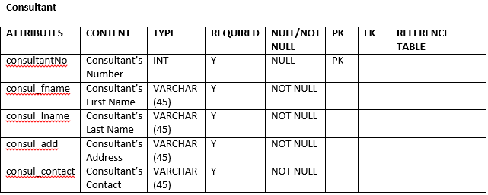
DATA DICTIONARY

Slide 14
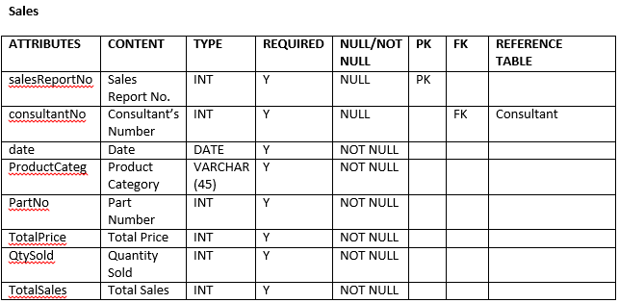
DATA DICTIONARY

Slide 15
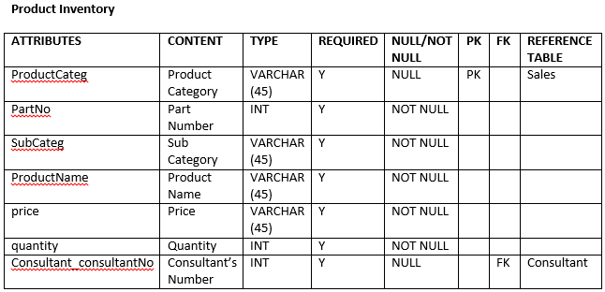
DATA DICTIONARY

Slide 16
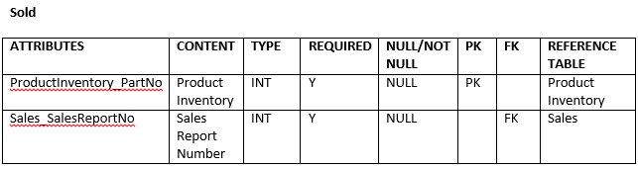
DATA DICTIONARY

Slide 17
ACTIVITY DIAGRAM

Slide 18
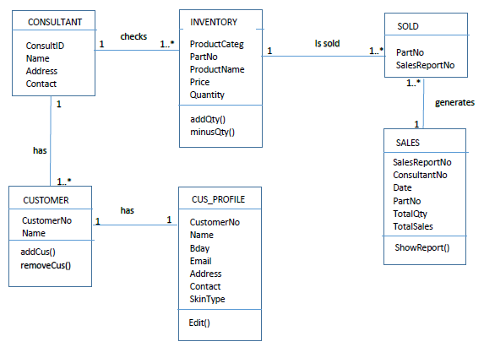
CLASS DIAGRAM

Slide 19
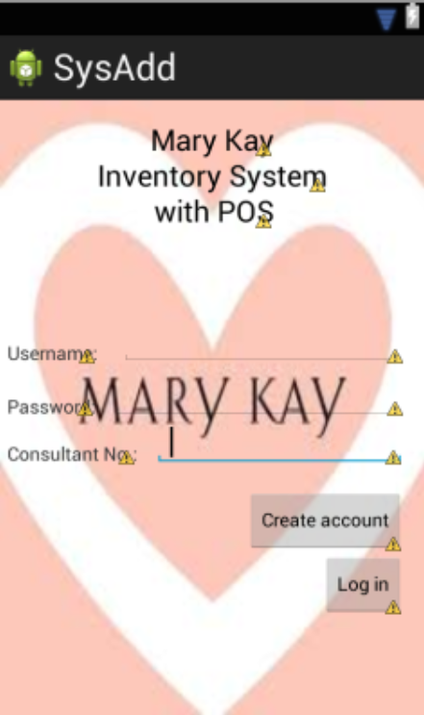
USER INTERFACE

Slide 20
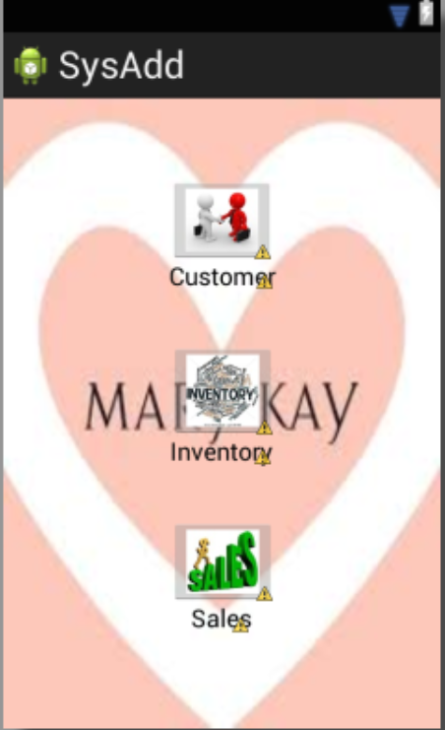
USER INTERFACE

Slide 21
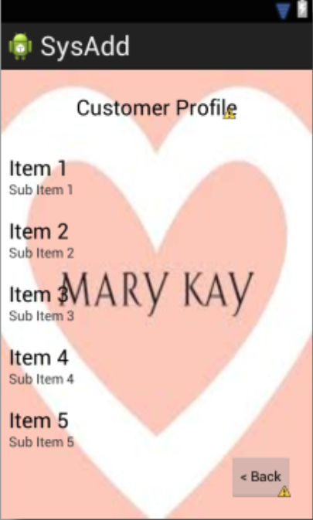
USER INTERFACE

Slide 22
USER INTERFACE

Slide 23
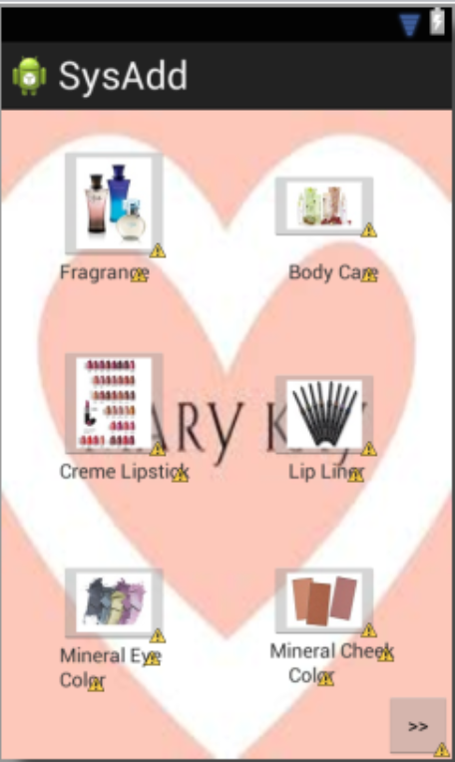
USER INTERFACE

Slide 24
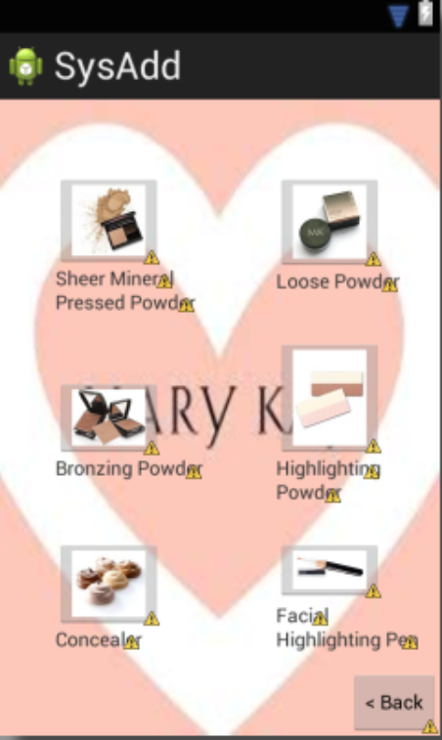
USER INTERFACE

Slide 25
USER INTERFACE

Slide 26
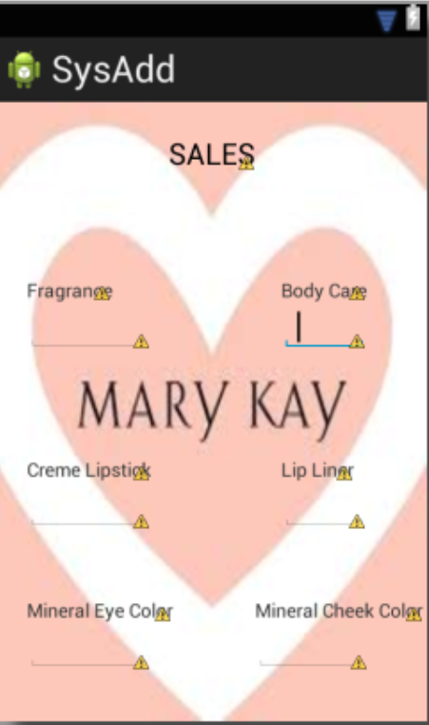
USER INTERFACE

Slide 27
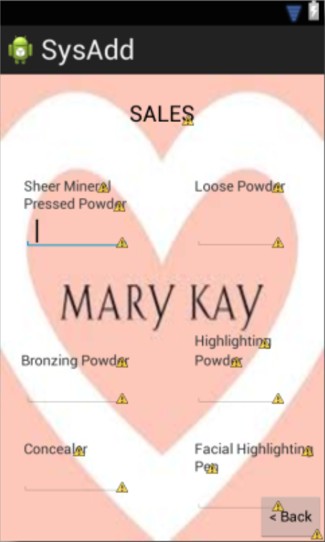
USER INTERFACE

Slide 28
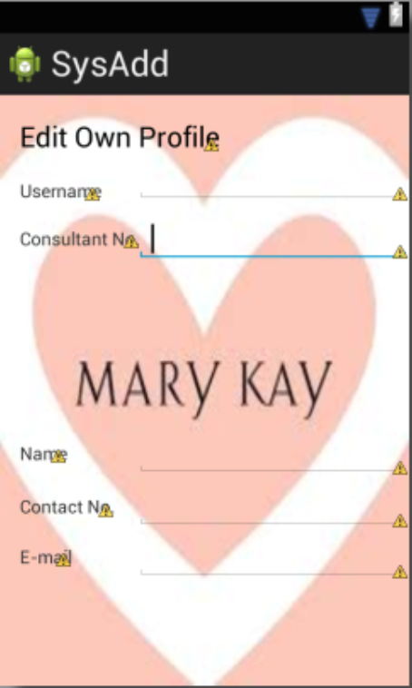
USER INTERFACE

Slide 29
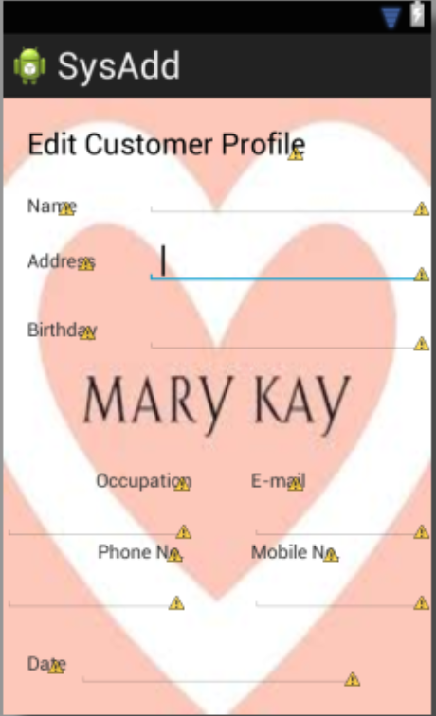
USER INTERFACE

